Slide 1

EXPERIMENTAL STATISTICS
BSCS-3A
ANALYZING MOVIES DATA SETS
TRENDS AND INSIGHTS
20 MARCH, 2025

Slide 2



INTRODUCTION
Understanding Movie Runtime Trends and Influences
The dataset provides comprehensive information about various movies, including their countries of origin, original release years, Netflix release dates (month and year), ratings, and runtimes.
Our group was given the flexibility to select a specific aspect of the dataset to analyze.
We chose to focus on examining the average runtime of movies by country and year, as well as exploring how the number of movies released per year may influence average runtimes, with the objective of identifying relevant patterns and trends within the data.
Next

Slide 3

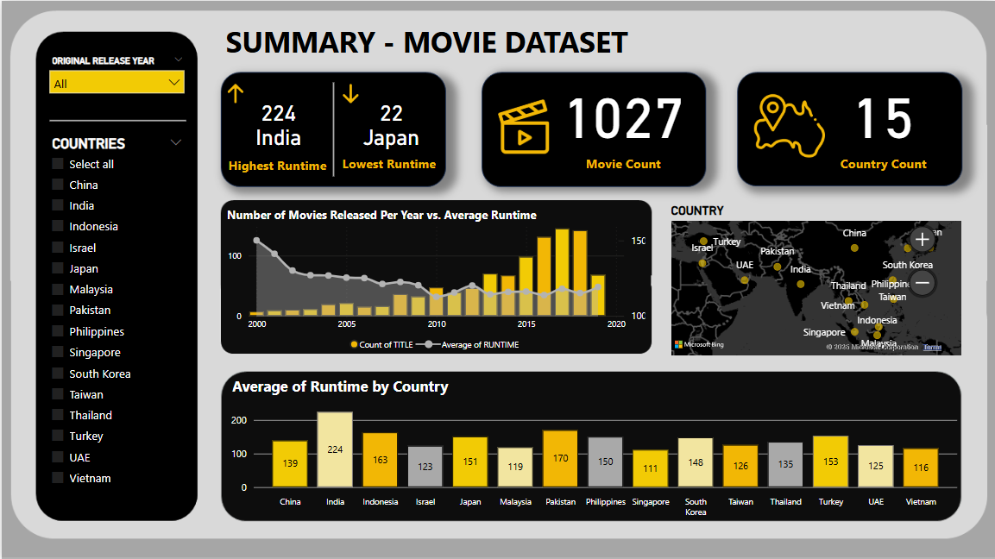
COMPARATIVE ANALYSIS OF PEAK YEARLY RUNTIMES ACROSS COUNTRIES
A statistical evaluation of the highest recorded yearly runtime for each country, determined by averaging annual data and identifying peak performance years.
INDIA
162.5
151
JAPAN
151
146
RUNTIME
INDONESIA
RUNTIME
RUNTIME
PAKISTAN
RUNTIME
2001
2014
2019
2015
YEAR
YEAR
YEAR
YEAR
SOUTH KOREA
135
135
UAE
125
124.4
RUNTIME
THAILAND
RUNTIME
RUNTIME
PHILIPPINES
RUNTIME
2012
2016
2014
2016
YEAR
YEAR
YEAR
YEAR
ISRAEL
123
CHINA
121.67
TAIWAN
120
TURKEY
118
RUNTIME
RUNTIME
RUNTIME
RUNTIME
2013
2011
2000
2006
YEAR
YEAR
YEAR
YEAR
VIETNAM
116
111
105
RUNTIME
SINGAPORE
RUNTIME
MALAYSIA
RUNTIME
2016
2016
2018
YEAR
YEAR
YEAR

Slide 4

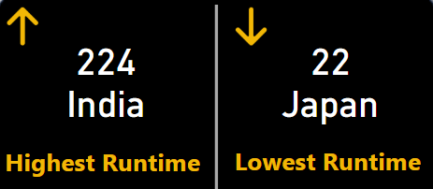
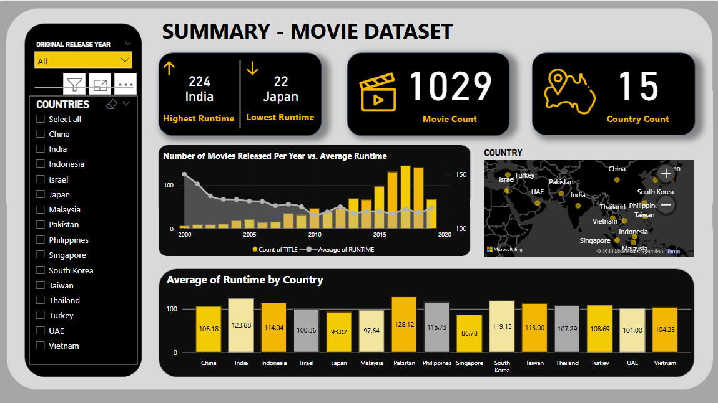
OVERVIEW

Slide 5

INSIGHTS
Peak Runtimes by Country
Peak Years and Trends
India recorded the longest peak runtime of 162.5 minutes in 2001, while Taiwan had the earliest peak in 2000, and Malaysia had the most recent in 2018.
Most countries reached their highest runtimes in the 2010s, with Japan (2019), Indonesia (2014), and Pakistan (2015) among the notable peaks.
Regional Patterns
Runtime Fluctuations
Southeast Asian countries like Thailand, Vietnam, and the Philippines peaked in 2016, suggesting a regional trend in extended runtimes.
A general increase in peak runtimes was observed until the mid-2010s, followed by variations in later years.

Slide 6

End
THANK YOU
2025 Experimental Statistics

